Slide 1
Health coverage for you and your family
Effective September 1, 2014

Slide 2
Agenda
TRS-ActiveCare Program Highlights
Enrollment Summary
Facts and Figures
2014-2015 Health Plan Options
ActiveCare 1-HD, ActiveCare Select and ActiveCare 2
HMO Plans
How to Enroll
Who is Eligible to Enroll
Cost of Coverage
Enrollment Support
Notes:
Program Highlights—We’ll start today’s meeting with an overview of enrollment and some interesting facts and figures about the program.
What’s New—Next, we’ll highlight the health plan options for 2014-2015 and provide a summary of each plan’s benefits and features.
How to Enroll—We’ll explain the eligibility rules for enrolling in the program and talk briefly about the cost of coverage for you and your family. We’ll also tell you where you can go for additional information, highlighting the online resources available to help you during enrollment and throughout the year.

Slide 3
What is TRS-ActiveCare?
Established and signed into law in 2001 (Chapter 1579, Texas Insurance Code)
A statewide health care benefits program for employees of school districts, charter schools, regional educational service centers and other educational districts
Law authorizes funding levels to help employees pay for coverage
1,127 districts/entities participate in TRS-ActiveCare (90% of eligible entities)
Notes:
The feedback we’ve received over the past year has revealed that many of you are new—a new entity joining the program for the first time or a new Benefits Administrator, responsible for helping employees enroll in various benefits plans and make changes. Comments have suggested that we step back and provide some background and additional information about TRS-ActiveCare with perhaps some history and facts and figures you can use to better describe the program to your employees and new recruits.
So with this back-to-basics approach in mind, let’s begin with “What is TRS-ActiveCare?” It’s the statewide health care benefits program for public education employees. It was established by the Texas Legislature and signed into law. An important aspect of the law is that it authorizes funding levels to help employees pay for coverage. The program effective date was September 1, 2002. Fully insured HMO options were added to the program in 2003.
Starting this year, the program is being administered by Aetna Life Insurance Company. Aetna handles health and wellness programs and claims processing for ActiveCare 1-HD, ActiveCare Select and ActiveCare 2 medical plans. WellSystems, a specialty partner of Aetna, provides enrollment and billing services. Caremark administers the prescription drug program for ActiveCare 1-HD, ActiveCare Select and ActiveCare 2 medical plans.

Slide 4
New plan administrators
Aetna will replace Blue Cross and Blue Shield® of Texas
Caremark will replace Express Scripts® as the administrator of our prescription drug benefits
Notes:
The TRS-ActiveCare medical plans being offered in 2014-2015 plan year will be administered by Aetna. Aetna has been administering the TRS retiree plans since 1986.
Aetna is one of America’s most experienced and progressive health insurance companies. Choosing Aetna to administer TRS-ActiveCare plans means you and your family can enjoy the advantages of one of the largest provider networks in America. You’ll get one-on-one support, your own Health Concierge, and many tools and resources to simplify your busy lives.
Caremark is the largest pharmacy health care provider in the United States. It’s network includes more than 64,000 pharmacies nationwide along with online ordering of maintenance medications.

Slide 5
ActiveCare 1-HD, ActiveCare Select and ActiveCare 2 Plans 2014-2015 Plan Year
Medical Plan Overview

Slide 6
ActiveCare 1-HD – out-of-pocket maximum
ActiveCare 1-HD meets IRS definition of a high deductible health plan for all coverage tiers
May contribute pretax dollars into a health savings account (HSA) to help pay for current health expenses and save for future qualified medical and retiree health expenses on a tax-free basis
Individuals can establish an HSA with banks and credit unions
 | 2013-2014 Plan Year | 2014-2015 Plan Year
Out-of-Pocket Maximum (employee only/family) | $3,850/$4,200 (does not include deductibles of $2,400/$4,800) | $6,350/$9,200 (includes deductibles of $2,500/$5,000, copays and coinsurance)
Notes:
ActiveCare 1-HD meets the IRS definition of a high deductible health plan (HDHP) for all tiers of coverage (employee only, employee and spouse, employee and child(ren), and employee and family), and offers you the opportunity to contribute pretax dollars into a health savings account (HSA).
An HSA allows you to pay for current health expenses and save for future qualified medical and retiree health expenses on a tax-free basis. You can establish an HSA with banks and credit unions. Employers may set up plans for employees as well, in which case the employer will generally be arranging the HSA for the employee.
TRS does not offer health savings accounts, but some entities participating in TRS-ActiveCare do provide this option to their employees. You can also establish an HSA by working directly with financial institutions offering this product. Many banks and credit unions offer custodial account services for individuals wishing to establish an HSA. TRS does not have a list of these institutions and does not endorse any particular HSA product. Please contact financial institutions serving your area to obtain further information.
The Affordable Care Act changed the way an out-of-pocket limit is calculated. In the 2013-2014 plan, the out-of-pocket maximum amount did NOT include the amount you paid out of your pocket to meet your deductible. In the new plan year, the out-of pocket maximum does include the amount you pay out of your pocket to meet the deductible. You will not be paying more in 2014-2015 plan year to meet your out-of-pocket maximum.

Slide 7
ActiveCare 2 out-of-pocket maximum
 | 2013-2014 Plan Year | 2014-2015 Plan Year
Out-of-Pocket Maximum (individual/family) | $4,000/$8,000 (does not include deductibles/copays) | $6,000/$12,000 (includes deductibles, medical copays and coinsurance)
Notes:
The Affordable Care Act changed the way an out-of-pocket limit is calculated. In the 2013-2014 plan the out-of-pocket maximum amount did NOT include the amount you paid out of your pocket to meet your deductible and copays. In the new plan year, the out-of-pocket maximum does include the amount you pay out of your pocket to meet the deductible and any medical copays (however, the copay for Bariatric Surgery does not count towards the out-of-pocket maximum).

Slide 8
Family deductible illustration
Amy covers a spouse and three dependents
Amy Ted Bob Sue Chris
ActiveCare 1-HD with a $5,000 family deductible
The family deductible may be met by one or more people
Plan pays benefits once entire $5,000 is met – there is no individual deductible to meet
$5,000
ActiveCare 2 with a $1,000 individual deductible and a $3,000 family deductible
Plan pays benefits for an individual as his/her deductible is met
Everyone helps to meet the family deductible, but no one person pays more than the individual amount
Amy
Ted
Bob
Sue
Chris
$1,000
$800
$600
$400
$200
Notes:
Family Deductibles and the Differences between Plans
A deductible is the amount of out-of-pocket expense that must be paid for health care services by the plan participant before becoming payable by the health plan. For ActiveCare 1-HD, before the plan pays for any of your family’s covered medical expenses, the entire amount of the deductible must be met. It can be met by one family member or a combination of family members; however, there are no benefits until covered expenses equaling the deductible amount ($5,000) have been incurred.
For ActiveCare 2 (and ActiveCare Select), the deductible applies to each covered person individually, up to the maximum per family. For example, under ActiveCare 2, which has a $1,000 individual and $3,000 family deductible, if Amy incurs $1,000 in medical bills, her deductible is met and the plan will pay any subsequent medical bills for her for the year even though the family deductible of $3,000 has not been met yet.

Slide 9
Out-of-Pocket (OOP) maximum illustration
Amy covers a spouse and three dependents
Amy Ted Bob Sue Chris
ActiveCare 1-HD with a $9,200 family OOP maximum
The family OOP maximum may be met by one or more people
Plan pays benefits once entire $9,200 is met – there is no individual amount to meet
$9,200
ActiveCare 2 with a $6,000 individual and $12,000 family OOP maximum
Plan pays benefits for an individual as his/her OOP maximum is met
Everyone helps to meet the family OOP maximum, but no one person pays more than the individual amount
Amy
Ted
Bob
Sue
Chris
$4,000
$5,000
$1,000
$1,000
$1,000
Notes:
Out-of-Pocket Maximum: Once you reach your plan’s out-of-pocket maximum, the plan pays 100% of any eligible expenses for the remainder of the plan year.
Under ActiveCare 1-HD, the family out-of-pocket maximum may be met by one or more people. The plan pays 100% of eligible member expenses once entire $9,200 is met.
Under ActiveCare 2, which has a $6,000 individual and $12,000 family OOP max, the plan pays benefits as each individual out-of-pocket maximum is met. Everyone helps to meet the family OOP max, but no one person pays more than the individual amount.

Slide 10
Choice POS II Network for ActiveCare 1-HD and ActiveCare 2
Always verify provider network status
Network:
Statewide no need to:
Select a Primary Care Physician
Obtain referrals for specialist care
Receive highest level of benefits:
Pay less for care
No balance billing
No claim forms:
Provider files claim for you
Non-Network:
You pay more of the cost of out-of-network benefits
Higher deductibles, coinsurance
You may need to file your own claim
You could be balance billed for amounts over allowed amount
Notes:
Before we talk about the plan options, let’s review the provider network of doctors and hospitals for the ActiveCare 1-HD and ActiveCare 2 plans. Administered by Aetna, the Choice POS II network for TRS-ActiveCare is one of the largest networks of its kind in the state of Texas. It offers access to over 45,800 physicians and more than 660 hospitals and over 26,000 other providers in Texas. Employees have the freedom to choose their own doctor at the point of service. No Primary Care Physician (PCP) or referrals required. Each time you or your eligible dependent needs health care, you will need to decide whether to see a network provider or an non-network provider.
With network providers:
Receive highest level of benefits
No claims to file in most cases (network provider will usually file the claims)
• No balance billing; network providers cannot bill for costs exceeding the allowable amount
With non-network providers:
Receive non-network level of benefits (reduced level from network)
May have to file own claims
May be billed for charges exceeding the Aetna allowable amount

Slide 11
Choice POS II Plan overview (Network level of benefits)
 | ActiveCare 1-HD | ActiveCare 2
Deductible | $2,500 employee only $5,000 family | $1,000 individual $3,000 family
Out-of-Pocket Maximum (includes medical copays/ deductibles/coinsurance) | $6,350 employee only $9,200 family | $6,000 individual 12,000 family
Coinsurance (Plan pays/participant pays) | 80% / 20% | 80% / 20%
Office Visit Copay | 20% after deductible | $30 for primary $50 for specialist
Primary means care provided by family practitioners, internists, OB/GYNs and pediatricians. All other physicians are specialists.
Notes:
ActiveCare 3 will be discontinued. If you are enrolled in that plan you will automatically be enrolled in ActiveCare 2 for 2014-2015 plan year. You must actively enroll in another plan if you do not want this plan in 2014-2015.
Plan overview. Let’s take a look at the two Choice POS II plans. This chart illustrates benefits when network providers are used. As mentioned previously, non-network benefits are also available; see the Enrollment Guide for information.
Deductibles: The set amount of out-of-pocket expense, if applicable, that must be paid for health care services by the covered person before the plan begins to share costs. For example, ActiveCare 1-HD has a $2,500 deductible per single and $5,000 per family, which must be met before the plan pays any benefits. The ActiveCare 2 deductible is $1,000 per individual and $3,000 per family.
Out-of-Pocket Maximum: If you reach your plan’s out-of-pocket maximum, the plan then pays 100% of any eligible expenses for the remainder of the plan year. New this year medical deductibles, most medical copays and coinsurance do apply to the out-of-pocket maximums. (Please note under the ActiveCare 2 plan, the bariatric surgery copay does NOT apply to the out-of-pocket maximum)
Coinsurance: The percentage of medical expenses that you and the plan share. For example, the coinsurance amount when using network providers for all plans is “80/20.” This means that the plan pays 80% and you pay 20% after any applicable deductible.
Copayments: The set amount you pay for certain medical services and prescription drugs at the time of service. Note: For ActiveCare 2, the copay depends on whether the doctor is “primary”or a specialist. Primary means care provided by family practitioners, internists, OB/GYNs, and pediatricians. All other physicians are specialists.
Family Deductibles and the Differences between Plans
A deductible is the amount of out-of-pocket expense that must be paid for health care services by the plan participant before becoming payable by the health plan. For ActiveCare 1-HD, before the plan pays for any of your family’s covered medical expenses, the entire amount of the deductible must be met first. It can be met by one family member or a combination of family members; however, there are no benefits until covered expenses equaling the deductible amount ($5,000) have been incurred.
For ActiveCare 2, the deductible applies to each covered person individually, up to the maximum per family. For example, under ActiveCare 2, which has a $1,000 individual and $3,000 family deductible, if your daughter incurs $1,000 in medical bills, her deductible is met and the plan will pay any subsequent medical bills for your daughter for the year even though the family deductible of $3,000 has not been met yet.

Slide 12
Choice POS II Plan overview (Network level of benefits)
Preventive Care Clarification
Services | ActiveCare 1-HD | ActiveCare 2
Preventive Care | Plan pays 100% (deductible waived) | Plan pays 100% (no copay required)
Routine eye exam (one per plan year) Hearing exam | 20% after deductible | $30 for primary $50 for specialist
100% coverage for certain age- and gender-specific preventive care services when network providers are used
Must be billed by provider as “preventive care”
Notes:
The TRS-ActiveCare Choice POS II plans provide 100% coverage for certain preventive care services when network providers are used. However, not all preventive care benefits are covered at 100%, including routine eye and vision exams and hearing exams. For example: Although age-specific vision “screenings” are covered 100% in the network provider’s office, routine eye and vision "exams," such as those performed by an optometrist or an ophthalmologist, are subject to applicable copayment, deductible and coinsurance.
Sample preventive care services covered 100% when using network providers:
Routine annual physicals (one per plan year)
Immunizations
Well-child care
Routine mammograms (one per plan year)
Routine colonoscopies
Bone density test
Screening for prostate cancer
Smoking cessation counseling services
Healthy diet/obesity screening/counseling

Slide 13
Choice POS II Plan overview (Network level of benefits)
Benefits (continued)
Services | ActiveCare 1-HD | ActiveCare 2
High-tech Radiology (CT scan, MRI, nuclear medicine) | 20% after deductible | $100 copay per service, plus 20% after deductible
Inpatient Hospital | 20% after deductible | $150 copay per day, plus 20% after deductible ($750 max copay per admission; $2,250 max/year)
Emergency Room | 20% after deductible | $150 copay, plus 20% after deductible (copay waived if admitted)
Outpatient Surgery | 20% after deductible | $150 copay per visit, plus 20% after deductible
Notes:
No plan changes for these services. A high-tech radiology copay is included for the ActiveCare 2 plan. The $100 copay is per service and applies to CT scans, MRIs and nuclear medicine when using network providers for these services. So, if a patient has a CT scan and an MRI on the same day, he/she will pay $200, plus deductible and coinsurance.
The inpatient hospital copay for ActiveCare 2 is $150 copay per day, plus deductible and coinsurance. The maximum copay per admission is $750 and the maximum per plan year is $2,250.
The emergency room and outpatient surgery copays for ActiveCare 2 are $150.

Slide 14
Choice POS II Plan overview (Network level of benefits)
Added Savings and Value with Quest Diagnostics®
Diagnostic Lab Services
 | ActiveCare 1-HD | ActiveCare 2
Quest Facility | 20% after deductible | Plan pays 100% (deductible waived)
Other Facility | 20% after deductible | 20% after deductible
Notes:
New for 2014-2015 plan year – Quest Diagnostics has agreed to lower lab rates for TRS-ActiveCare participants. The ActiveCare 2 plan covers lab services at 100% when using Quest Diagnostics for lab work.

Slide 15
New ActiveCare Select Plan
Always verify provider network status
Network Only Plan:
Statewide no need to:
Select a Primary Care Physician
Obtain referrals for specialist care
Two Networks:
Aetna Whole Health (ACO)
Aetna Select (Open Access)
Receive highest level of benefits:
Pay less for care
No balance billing
No claim forms:
Provider files claim for you
Non-Network:
No coverage except in a true emergency
Notes:
TRS-ActiveCare Select Plan is a new health plan option made available for the 2014-2015 plan year. With ActiveCare Select, you are free to see any network provider without a referral. However, there is NO coverage if you see a provider who is not in the plan network. The only exception is for a true medical emergency.

Slide 16
ActiveCare Select Plan overview (Network level of benefits)
If you live in one of these counties | Aetna Whole Health Network
Bexar Guadalupe Comal Kendall | Baptist Health System and Health Texas Medical Group
Collin Parker Dallas Rockwall Denton Tarrant Ellis | Baylor Scott & White Quality Alliance
Ft. Bend Harris Montgomery | Memorial Hermann Accountable Care Network
Hays Travis Williamson | Seton Health Alliance
If you live in a county not listed above | Aetna Select Open Access Network
Notes:
There are two networks that make up the ActiveCare Select plan, Aetna Select (Open Access) network or Aetna Whole Health Network.
Aetna Whole Health is an Accountable Care Organization (ACO) network. With Aetna Whole Health, you have a health care team of doctors, nurses, therapists and other providers whose goal is to work together with you to meet your unique needs and keep you healthy.
Better health, better care, better cost
This is what Aetna Whole Health is all about. It is a participant-centered approach that may differ from care you have had in the past.
Here are some of the ways it is different. The members of your care team:
Strive to keep you healthy or improve your health, not just treat you when you are sick or injured
Can better coordinate your care because they can see how other doctors are treating you, what medicines you are taking, your lab results, your health history and more
Are up to date on medical guidelines and clinical information so they can spot problems early and develop personalized care plans for you
Encourage you to play an active and informed role in your health and health care decisions
If you live in or around San Antonio, Dallas, Austin or Houston (counties listed) and elect ActiveCare Select as your 2014-2015 plan option, you will be REQUIRED to use providers who belong to the Aetna Whole Health network. If you do not live in one of these counties, you may choose a provider from the Aetna Select Open Access Network.

Slide 17
ActiveCare Select Plan overview (Network level of benefits)
Preventive Care Clarification
Services | ActiveCare Select
Preventive Care | Plan pays 100% (no copay required)
Routine eye exam (one per plan year) Hearing exam | $30 for primary $60 for specialist
100% coverage for certain age- and gender-specific preventive care services when network providers are used
Must be billed by provider as “preventive care”
Notes:
The TRS-ActiveCare Select plans provide 100% coverage for certain preventive care services when network providers are used. However, not all preventive care benefits are covered at 100%, including routine eye and vision exams and hearing exams. For example: Although age-specific vision “screenings” are covered 100% in the network provider’s office, routine eye and vision “exams,” such as those performed by an optometrist or an ophthalmologist, are subject to applicable copayment, deductible, and coinsurance.
Sample preventive care services covered 100% when using network providers:
Routine annual physicals (one per plan year)
Immunizations
Well-child care
Routine mammograms (one per plan year)
Routine colonoscopies
Bone density test
Smoking cessation counseling services
Healthy diet/obesity screening/counseling

Slide 18
ActiveCare Select Plan overview (Network level of benefits)
Benefits (continued)
Services | ActiveCare Select
High-tech Radiology (CT scan, MRI, nuclear medicine) | $100 copay per service, plus 20% after deductible
Inpatient Hospital | $150 copay per day, plus 20% after deductible ($750 maximum copay per admission)
Emergency Room | $150 copay, plus 20% after deductible (copay waived if admitted)
Outpatient Surgery | $150 copay per visit, plus 20% after deductible
Notes:
Similar to ActiveCare 2, the high-tech radiology has a $100 copay per service and applies to CT scans, MRIs and nuclear medicine when using network providers for these services. So, if a patient has a CT scan and an MRI on the same day, he/she will pay $200, plus deductible and coinsurance.
The inpatient hospital copay for ActiveCare Select is $150 copay per day, plus deductible and coinsurance. The maximum copay per admission is $750. The emergency room and outpatient surgery copays are $150.

Slide 19
ActiveCare Select Plan overview (Network level of benefits)
Added Savings and Value with Quest Diagnostics®
Diagnostic Lab Services
Facility | ActiveCare Select
Quest Facility | Plan pays 100% (deductible waived)
Other Facility | 20% after deductible
Notes:
New for 2014-2015 plan year – Quest Diagnostics has agreed to lower lab rates for TRS-ActiveCare participants. ActiveCare Select covers lab services at 100% when using Quest Diagnostics for lab work.

Slide 20
ActiveCare 1-HD, ActiveCare Select and ActiveCare 2 Plans 2014-2015 Plan Year
Health and Wellness Resources
Notes:
Helping you live a healthier life
Managing your health is more than just doctor visits and lab tests. Aetna provides several resources so you and your covered family members can reach your health and wellness goals.

Slide 21
Teladoc
Teladoc is an affordable alternative to emergency room and urgent care. Many common medical issues can be resolved through the convenience of just a phone call – 24/7/365
Highlights include….
Copays waived for ActiveCare 2 and ActiveCare Select plans; only $40 consultation fee for ActiveCare 1-HD plan.
Board certified providers specializing in family practice, internal medicine and pediatrics.
Common diagnosis and treatment of common conditions such as sinusitis, upper respiratory infection, urinary tract infection, bronchitis, ear infections, influenza and the common cold.
Consults available wherever the patient is – at home, at work, or travelling within the United States.
Guaranteed member call back within 60 minutes! The average call back time is 20-30 minutes or schedule a call back at a specific time.
Diagnosis, recommended treatment and prescriptions ordered when appropriate.
A copy of the consult record will be sent to the member’s PCP upon request.
Notes:
With Teladoc you have phone access to a national network of physicians for non-emergency medical assistance. Teladoc physicians include general practitioners, internists and pediatricians. They can diagnose, treat and prescribe medication for many common medical issues such as the flu, colds and other infections.
When your doctor’s office is closed or you can’t get to a doctor because of your work schedule or location, Teladoc is available by phone, 24 hours a day, 7 days a week.
And you’ll save money too! Covered 100% in ActiveCare Select and ActiveCare 2 plans; $40 consultation fee (applies to deductible and out-of-pocket maximum) for ActiveCare 1-HD.

Slide 22
Health and wellness resources
For personal help with health conditions, challenges and goals
Simple Steps To A Healthier Life®
Aetna Health Connections
Beginning Right® Maternity Program
Aetna Care Advocate Team
National Medical Excellence Program®
24-Hour Nurse Information Line
SM
Notes:
It can be hard to lose weight, take care of a chronic condition, navigate complex medical care or reach an especially tough health goal. But with Aetna’s health and wellness resources, you don’t have to go it alone. You’ll have one-on-one support from our trained nurses, health coaches and other professionals.
Here’s a quick tour of some of Aetna’s programs and services:
With Simple Steps, you have online help to make healthy changes. You start by taking about 20 minutes to complete a confidential health assessment. You then get a personalized action plan that recommends online wellness programs for them, based on their needs. The programs are self-paced and take participants step by step toward goals that include weight loss, stress management, healthier eating, better sleep, smoking cessation and overcoming depression.
Aetna Health Connections is a condition management program that provides support for more than 35 chronic conditions. Members are matched with a trained nurse who can help them stay on track with medication, follow your doctor’s treatment plan, and better understand and manage your condition on a daily basis.
Expecting moms can also benefit from the advice and guidance of ob/gyn nurse consultants with the Beginning Right program. The nurses work one-on-one over the phone with participants, advising on prenatal and newborn care, preterm labor and other topics. Beginning Right also includes a pregnancy risk survey and the Smoke-free Moms-to-Be smoking cessation program.
The Aetna Care Advocate Team, called CAT, offers special help to members dealing with multiple health needs or complex conditions. CAT nurses and clinicians can coordinate services, answer questions and provide information and advice that helps members better navigate the health care system and make the most of their health benefits.
Members facing transplant surgery or other complex procedures can get help and support through Aetna’s National Medical Excellence Program. It’s a voluntary program, and members who participate will have care provided at one of the Institutes of Excellence hospitals. These facilities are chosen for its experience and outcomes with organ transplants and complex medical care. The program also helps with case management and coordination of follow-up care.
The 24-Hour Nurse Information Line puts callers in touch with a registered nurse who can answer questions and give advice, any time of the day or night. While nurses can diagnose or prescribe, they can tell you about medical conditions and tests, help you get ready for a doctor’s visit, and even give you advice on what you can do about a problem until you’re able to see the doctor.

Slide 23
Aetna Health Concierge
A single source for help and information
Answers to benefits questions
Help to find care and services
Information about helpful programs and resources
A personal guide to Aetna Navigator®
Notes:
With the Aetna Health Concierge, you will have a single point of contact for benefits and wellness help and information.
One toll-free number puts you in touch with a benefits expert who can help you understand what’s available to you and how to use it – from benefits and coverage, to programs, services and tools. The Concierge can help untangle claims, talk about what’s covered and what isn’t, and explain how care is paid for.
The Health Concierge is also a health and wellness resource. You can get help to find the right doctor for a certain condition or problem. The Concierge can even help with appointments and follow-up care and services.
When the opportunity arises, the Concierge can direct you to the appropriate wellness program for your particular needs.
While on the phone with the Concierge, you can get a guided tour of Aetna Navigator, your secure member website. You can follow along as the Concierge helps them register, log in and see all the site has to offer.
To reach an Aetna Health Concierge, call TRS-ActiveCare Customer Service and ask to speak to a Health Concierge.

Slide 24
Aetna discount programs
For savings on a wide variety of health needs
Fitness memberships and equipment
Hearing aids and exams
Vision care
Weight management programs
Natural products and services
Notes:
As Aetna members, you and your covered family members will be able to save money on health-related products and services with their Aetna discounts.
Fitness discounts apply to gyms that belong to the GlobalFit network. You can save on membership fees, try out a gym and, in certain locations, get guest passes as well. You can also save on home fitness equipment such as treadmills and elliptical trainers
For hearing care, you have two choices. With Hearing Care Solutions, you can take advantage of discounts on hearing aids, batteries and in-office service. With HearPO, you can save on programmable and digital hearing aids, batteries, repairs and hearing exams.
Vision care discounts save you money on eye exams, contacts and eyeglasses, including designer frames. The discounts can be used at national chains such as JCPenney Optical, LensCrafters, Target Optical, Sears Optical and Pearle Vision.
You can save on weight management programs too. These include CalorieKing, Jenny Craig and Nutrisystem. Depending on the program, services can include meal plans, food delivery, face-to-face or phone support, personalized menus and more.
If you use supplements, massage and alternative therapies you can use natural products and services discounts. You’ll save on massage therapy, acupuncture, chiropractic and nutrition services.
These are just the highlights. Other discounts cover health-related books and videos, entertainment, and more. You can log in to Aetna Navigator at www.trsactivecareaetna.com to learn more about these discounts and get started using them.

Slide 25
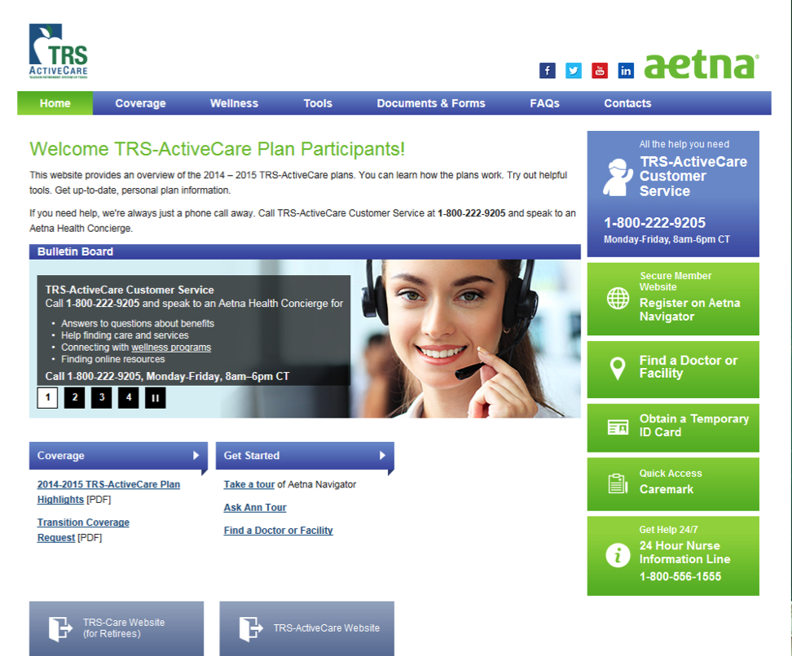
TRS-ActiveCare Aetna website
Notes:
Aetna has a custom website for TRS-ActiveCare medical plan participants. There you will have access to all the tools and resources Aetna has to offer – from finding an network doctor to reaching a Health Concierge to discuss a complex health condition. It is all there in one convenient place at www.trsactivecareaetna.com.

Slide 26
Your secure member website
Aetna Navigator
Check benefits and claims
Search for doctors in the network
Order additional ID cards, or print a temporary ID card
Cost of Care tools – Know the cost before you go
Take a confidential health assessment
Notes:
Aetna Navigator is a secure portion of the Aetna site that ActiveCare 1-HD, ActiveCare Select and ActiveCare 2 participants can use to access their personal membership and claims information.
Once enrolled and registered you can:
Check the status of a claim and view claim summaries
Search for network providers
Confirm who is covered under your plan
Request a replacement ID card or print a temporary one
Get cost estimates on services before you go
Take the health assessment
View your personal health record
Get started with Aetna wellness programs
Connect with a Health Concierge

Slide 27
Choose wisely – save money
Aetna Member Payment Estimator
Helps you make smarter care choices
Compares costs for common procedures and treatments
Know the cost of the care before you go
Notes:
Aetna has many resources for you to make informed health decisions. One of the tools available to you is the Member Payment Estimator – this tools lets you find and compare actual costs for common procedures and treatments before you receive care. Your search results are run through Aetna’s claim system, so your out-of-pocket cost will reflect how much of your deductible you have met, and any copays, coinsurance and plan limits that may apply.
You can find this tool on Aetna Navigator under the Cost of Care box.

Slide 28
Mobile apps and tools
Aetna Mobile Secure Site – Log-in Required
Find a network doctor
Check your plan coverage
Check on a claim
Show you ID card
Contact TRS-ActiveCare Customer Service
CarePass
Connects you to health and fitness apps
Set goals
Track your nutrition, fitness, health and sleep
iTriage
Check a symptom
Look up a conditions
Find the right doctor
Check on ER wait times
Notes:
Mobile apps put health and benefits features and functionality right into your hands. It’s the information you need, the way you want to access it.
Aetna Mobile lets you pull up Aetna Navigator on your smartphone or other device. You can look up a doctor, show your member ID card, check a claim payment, look at your Personal Health Record, and much more. Aetna Mobile works with Apple mobile digital devices and Android-powered phones.
CarePass is a single platform that connects you to your favorite health and fitness trackers. These include FitBit, Lose It!, Body Media, Zipongo and others.
With iTriage, you can know more about a health problem before you go to the doctor. You can look up conditions and procedures, and match a doctor or facility to your needs. You can even get ER wait times in local hospitals.

Slide 29
ActiveCare 1-HD, ActiveCare Select and ActiveCare 2 2014-2015 Plan Year
Prescription Drugs
Notes:
Let’s discuss the prescription drug benefits administered by Caremark for the ActiveCare 1-HD, ActiveCare Select and ActiveCare 2.

Slide 30
Your Prescription Drug Plan
Caremark administers your prescription drug plans on behalf of TRS
ActiveCare 1-HD, ActiveCare Select and ActiveCare 2 plans
Benefit includes both a retail and mail component
Caremark has its own mail-order pharmacy where specialist pharmacists focus on compliance and lower cost options for the patient, and the automated filling system ensures the prescription is filled accurately
Notes:
Caremark administers the prescription drug plan on behalf of TRS-ActiveCare. The program has both a retail and mail component. The retail coverage has over 65,000 pharmacies in network. And, of those, 4,700 pharmacies participate in the Retail-Plus network. Caremark also has a mail-order facility. By filling your long-term medications through mail order or participating Retail-Plus maintenance pharmacies.
Through the mail-order pharmacy, you can get up to a 90-day supply delivered directly to you at a lower copay. The mail-order pharmacy is also staffed by pharmacists who have been specially trained in certain therapeutic categories.

Slide 31
Prescription Drug benefits – network level
Features | ActiveCare 1-HD | ActiveCare Select | ActiveCare 2
Drug Deductible (per person, per plan year) | Subject to plan year deductible | $0 generic; $200 brand | $0 generic; $200 brand
Retail Short-Term (up to 31-day supply) Tier 1 (Generic) Tier 2 (Preferred Brand) Tier 3 (Non-Preferred Brand) | 20% coinsurance after deductible | $20 $40* 50% coinsurance | $20 $40* $65*
Retail Maintenance (after first fill, up to 31-day supply) Tier 1 (Generic) Tier 2 (Preferred Brand) Tier 3 (Non-Preferred Brand) |  | $25 $50* 50% coinsurance | $25 $50* $80*
Mail Order % Retail-Plus (up to 90-day supply) Tier 1 (Generic) Tier 2 (Preferred Brand) Tier 3 (Non-Preferred Brand) |  | $45 $105* 50% coinsurance | $45 $105* $180*
Specialty Medications (retail or mail) | 20% coinsurance after deductible | 20% coinsurance per fill | $200 per fill (up to 31-day supply) $450 per fill (32-to 90-day supply)
* If you obtain a brand-name drug when a generic equivalent is available, you are responsible for the generic copayment plus the cost difference between the brand-name drug and the generic drug. Chart illustrates benefits when network pharmacies are used. Non-network benefits are also available; see Enrollment Guide for more information.
Notes:
Here’s an overview of the prescription drug benefits for the ActiveCare 1-HD, ActiveCare Select and ActiveCare 2 plans. This chart illustrates benefits when network providers are used. Non-network benefits are also available; see Enrollment Guide for more information.

Slide 32
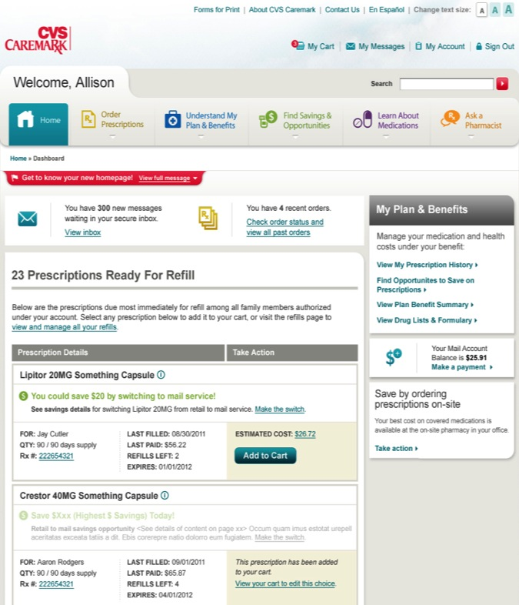
Caremark’s online tools and mobile apps help connect patients and their caregivers
Prescription Alerts
Alerts you to refills available at mail or retail, remaining refills, last refill, past due refills; add to cart right there
Savings Opportunities
Displays savings for each member of the family, with ability to request a medication change online
Recent Orders
Provides capability to track orders and alerts members of any changes to status
Refill and Manage
Family prescriptions can be managed in one place with a few clicks
Notes:
The Caremark website empowers you by providing the personalized information you need to make better-informed health decisions regarding prevention and treatment. It also enables you to make better-informed financial decisions regarding the cost of medication. It is a one-stop shopping tool for all prescription-related items. And, it’s available anytime.

Slide 33
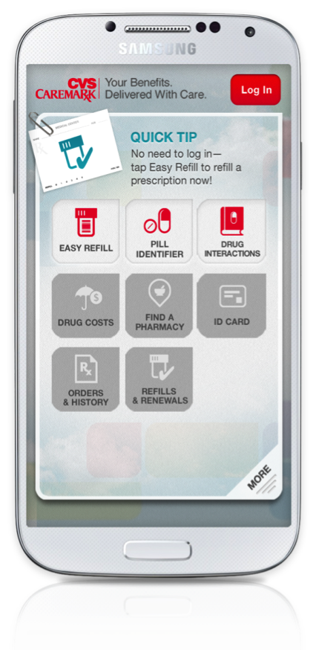
Innovation that can help participants make better decisions for healthier outcomes
Only PBM to offer native pre-log in functions for iPhone and Android
Scan to refill multiple Rx checkout
Pill identifier
Drug interaction checker
After log in functions available
Find drug costs
Find a pharmacy in network
View digital ID card
See prescription orders and history
Refill prescriptions
Notes:
Caremark has mobile tools that allow you to refill prescriptions, get drug interaction information, find a network pharmacy, determine the cost of drugs and much more. All from a mobile phone or tablet!

Slide 34
Specialist Pharmacists are an integral part of the health care continuum
The Caremark Specialty Pharmacy provides not only your specialty medicines, but also personalized pharmacy care management services:
Access to a team of clinical experts that are specially trained in your condition
On-call pharmacist 24 hours a day, seven days a week
Coordination of care with you and your doctor
Convenient delivery to the address of your choice, including your doctor’s office
Medicine- and condition-specific education and counseling
Insurance and financial coordination assistance
Confidential and empathetic care
Online support and resources through www.CVSCaremarkSpecialtyRx.com, including condition‑specific information and the specialty pharmacy drug list
Notes:
Innovative Specialty Management:
Decades of clinical experience and deep insight into the specialty drug pipeline, inform this innovative specialty pharmacy management program, which helps control specialty pharmacy costs and promotes optimal clinical outcomes for members.
To help improve member behavior, the program, CareTeams, works to identify gaps in care, ensure proper drug usage and optimize member adherence. Condition-specific teams also provide a dedicated source of information, education and support for members.
Member Benefits and Satisfaction:
Members benefit from the consistent clinical oversight provided by their teams, and have access to 99.9 percent of all specialty medications. Compared to other specialty providers, members served are 36 percent more likely to remain on therapy. And, more than 96 percent of members and clients report being satisfied with these specialty programs.

Slide 35
Information resources
TRS Website – www.trs.state.tx.us/trs-activecare
Pharmacy Benefit Highlights
List of maintenance medications
FAQs
Download forms
Caremark Participant Website – www.caremark.com/trsactivecare
Prior authorization list
Formulary information
Locate a participating pharmacy
Generics Rx Advantage
My Rx Choices® / Price a Medication
Health and wellness information
Mobile App
Check prescription status
Order mail order refills
Download forms
Caremark widget
Customer Service – 1-800-222-9205
Benefits Booklet

Slide 36
What if I have questions?
Personalized Service
Call TRS-ActiveCare customer service for:
Claim questions/status
Network provider information
Medical and Rx coverage questions
Inquiries (telephone and email)
ID card requests
Transition of care information
Help with online tools
TRS-ActiveCare Customer Service 1-800-222-9205
Notes:
Questions? The ActiveCare 1-HD, ActiveCare Select and ActiveCare 2 customer service team can help answer your questions about your claims, medical coverage and prescription drug coverage. They can also assist you with ID card requests, transition of care information and help with online tools such as Aetna Navigator, the cost of care tools as well as the new online health assessment.

Slide 37
HMO Plan Option 2014-2015 Plan Year
FirstCare Health Plans

Slide 38
Company overview
Joined TRS-ActiveCare program in 2003; currently cover 20,253 school employees and their dependents
Hospital-based health plan owned by Covenant Health in Lubbock and Hendrick Medical Center in Abilene
Focus exclusively on the Texas market with offices in Abilene, Amarillo, Austin, Lubbock and Waco
Added 10 new counties to service area in 2014
For a complete list of plan changes, please refer to your evidence of coverage and schedule of benefits.
Notes:
FirstCare has experienced steady membership growth over the past 10 years. Currently, more than 20,000 school employees and their dependents are covered making FirstCare the largest HMO provider for TRS.
FirstCare believes one of the main reasons for membership growth is because they’re a hospital-based health plan. FirstCare is owned by two Texas hospitals – Covenant Health in Lubbock and Hendrick Medical Center in Abilene. Considering that the owners are hospitals, they instill the need to put patient care first with the understating that health care decisions are made by local health providers; not by someone on the phone in a different state.
FirstCare is committed to Texas communities by having local offices where members can come by and ask questions. Local offices are active in promoting healthy lifestyle programs by sponsoring health education classes within their communities.
Finally, the company’s mission is to provide you with comprehensive health care coverage at an affordable price. Health care costs have been rapidly increasing due to new technology, drugs and increase in utilization. That is why FirstCare has partnered with some of the largest health providers in the service area to help control those costs. Those partnerships have allowed FirstCare to reduce rates this year while enhancing benefits.

Slide 39
Rate overview
Premiums for 2014 increased by 11% nationally*
FirstCare reduced premiums for 2014-2015
Coverage Category | 2013-2014 Premiums | 2014-2015 Premiums
Employee Only | $391.50 | $390.14
Employee and Spouse | $985.06 | $977.76
Employee and Child(ren) | $622.62 | $618.94
Family | $994.84 | $987.44
Source: forbes.com
For a complete list of plan changes, please refer to your evidence of coverage and schedule of benefits.
Notes:
FirstCare’s goal is to provide comprehensive coverage at an affordable price. While health care premiums have increased an average of 11 percent this year nationally, FirstCare is happy to announce that they have reduced the premiums for the 2014-2015 plan year.

Slide 40
Benefit highlights
100% preventive care coverage
Reduced office visit copayments
Last year $25 This year $20
Reduced deductible
Last year $600 This year $450*
Max out-of-pocket now includes medical deductible & copayment
No Rx deductible for generic drugs
For a complete list of plan changes, please refer to your evidence of coverage and schedule of benefits.
Notes:
In addition to reducing rates, FirstCare made some significant benefit enhancements. Reduced the PCP office visit copayment to $20 and also reduced the deductible. For individuals, this year’s deductible is $150 less than last year and for families it’s $375 less than last year. And now the deductible and copayment are applied to the out-of-pocket maximum. Also waived the Rx deductible for generic drugs, which means you only have to pay your $10 copayment for each generic drug prescription.

Slide 41
Benefit highlights
No referrals to network specialists
College-age dependents living outside our service area have full coverage (address must be on file)
NOTE: Care must be accessed through our affiliate provider networks
Secure online access to membership and claim information at firstcare.com
For a complete list of plan changes, please refer to your evidence of coverage and schedule of benefits.
Notes:
If you need to see a participating specialist, you can go directly to one or coordinate through your primary care physician. FirstCare encourages members to develop a relationship with a primary care physician. In many instances, a primary care physician can resolve the issue or help guide to the appropriate specialist. Also, by accessing care through a primary care physician, you will have a lower office visit copayment. The provider network includes more than 2,400 specialists in 103 counties throughout the north, west, and central regions in Texas. A complete listing of providers is available at www.firstcare.com under the “Find a Physicians” tab. Look for the TRS-ActiveCare directory.
When accessing care from participating providers, all you have to do is show your ID card. FirstCare will coordinate payment directly with providers thus eliminating the need to file routine claim forms.
Many of FirstCare members have college-age dependents that reside outside the service area. No problem. They are covered for all services, including routine, non-emergency care as long as the care is provided by a doctor or facility that is contracted with FirstCare or one of their affiliated networks. In order to receive this comprehensive level of benefits, the student’s out-of-area address must be on file with FirstCare. This can be done by simply calling the Customer Service Department at 1.800.884.4901.
FirstCare members have access to a robust secure website. You can review claim and benefit information, request new ID cards and research ways to promote a healthy lifestyle. This year, FirstCare has added a new wellness program and improved the online provider directory.

Slide 42
Medical benefits for 2014-2015 significant benefit enhancements
Reduced PCP Office Visit Copayment
2014-2015
Deductible $450 per individual $1,125 per family
Out-of-Pocket Maximum includes medical deductible & copayments $4,450 per individual $9,125 per family
Office Visit Primary Care $20 Specialist $60
Inpatient / Outpatient 25% after deductible (member share)
For a complete list of plan changes, please refer to your evidence of coverage and schedule of benefits.
Notes:
This chart outlines some of the changes in the medical plan. Please refer to the Schedule of Benefits and Evidence of Coverage for a complete overview of coverage.

Slide 43
Rx benefits for 2014-2015
No Rx deductible for generic drugs
2014 – 2015
Deductible $100 per individual $300 per family
Rx Out-of-Pocket Maximum includes drug deductible & copayments $4,450 per individual $9,125 per family
Copayments Generic (Tier 1) deductible waived $10 Preferred Brand Name (Tier 2)* $30 Non-Preferred Brand Name (Tier 3)* $60 Specialty (Tier 4)* 20% *after deductible
For a complete list of plan changes, please refer to your evidence of coverage and schedule of benefits.
Notes:
This chart outlines some of the changes to the prescription drug plan. Please refer to the Schedule of Benefits and Evidence of Coverage for a complete overview of coverage.

Slide 44
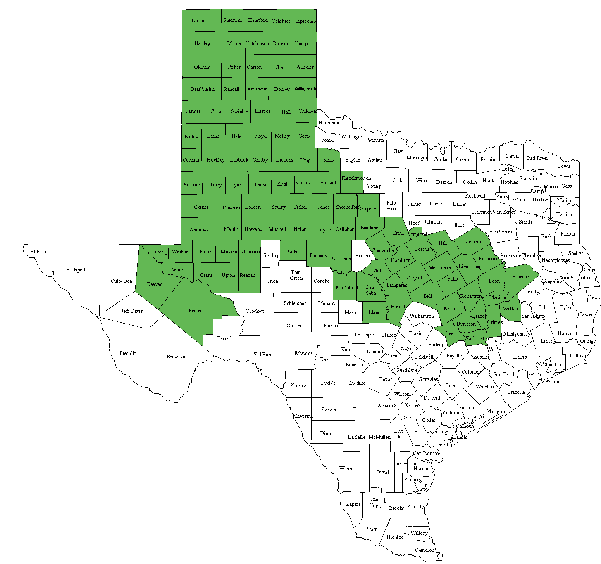
FirstCare Service Area – 103 counties across Texas
To be eligible to enroll in FirstCare, you must live or work in one of the shaded counties.
Notes:
In order to be a member in the FirstCare plan, you must live, reside or work in one of the shaded areas. FirstCare’s service area includes 103 counties, thus providing the largest service area for those wanting to enroll in an HMO.
Within the 103 counties, there are more than 1,600 primary care physicians and 2,400 specialists including some of the most well respective hospitals. Before seeking care, remember to check your provider’s participation status.
The next couple of slides outline some of the providers participating in the network.

Slide 45
Abilene Region Provider Network
FirstCare has a comprehensive network of local physicians, hospitals, and pharmacies that offer a full range of medical services.
A complete list of network providers is available at www.firstcare.com
Local Representative Contact Whitney Hill whill@firstcare.com 325-670-3885
Abilene Hospital:
Hendrick Medical Center
Other Regional Hospitals:
Anson General Hospital
Ballinger Memorial Hospital
Coleman County Medical Center
Comanche County Medical Center
Eastland Memorial Hospital
Fisher County Hospital
Hamlin Memorial Hospital
Haskell Memorial Hospital
Heart of Texas Memorial Hospital
Hendrick Medical Center
Knox County Hospital
Mitchell County Hospital
North Runnels Hospital
Rolling Plains Memorial Hospital
Stamford Memorial Hospital
Stephens Memorial Hospital
Stonewall Memorial Hospital
Throckmorton County Memorial Hospital

Slide 46
Amarillo Region Provider Network
FirstCare has a comprehensive network of local physicians, hospitals, and pharmacies that offer a full range of medical services.
A complete list of network providers is available at www.firstcare.com
Local Representative Contact Dana Nicklaus dnicklaus@firstcare.com 806-356-5265
Amarillo Hospitals:
Baptist St. Anthony’s Hospital (BSA)
Plum Creek Specialty Hospital
Other Regional Hospitals:
Childress Regional Medical Center
Collingsworth General Hospital
Coon Memorial Hospital
Golden Plains Community Hospital
Hansford County Hospital
Hardeman County Memorial Hospital
Hemphill County Hospital
Hereford Regional Medical Center
Moore County Hospital District
Ochiltree Hospital District
Pampa Regional Medical Center
Parkview Hospital
Parmer County Community Hospital
Shamrock General Hospital
Swisher Memorial Hospital

Slide 47
Lubbock Region Provider Network
Lubbock Hospitals:
Covenant Health System
University Medical Center
Other Regional Hospitals:
Brownfield Regional Medical Center
Cochran Memorial Hospital
Cogdell Memorial Hospital
Covenant Health System
Crane Memorial Hospital
Crosbyton Clinic Hospital
HealthSouth Rehabilitation Hospital
Iraan General Hospital District
Lamb Healthcare Center
Lynn County
Martin County
McCamey Hospital
Medical Arts Hospital
Medical Center Hospital
Midland Memorial Hospital
Muleshoe Area Medical Center
Pecos County Memorial
Permian Regional Medical Center
Plains Memorial Hospital
Rankin County Hospital
Reeves County Hospital
Seminole Memorial Hospital
Winkler County Memorial Hospital
W J Mangold Memorial Hospital
Yoakum County Hospital
FirstCare has a comprehensive network of local physicians, hospitals, and pharmacies that offer a full range of medical services.
A complete list of network providers is available at www.firstcare.com
Local Representative Contact Dana Johnston djohnston@firstcare.com 806-784-4326

Slide 48
Waco/Bryan-College Station Region Provider Network
Waco Hospitals:
Providence Health Center
Bryan/College Station Hospitals:
St. Joseph Regional Health Center
College Station Medical Center
Other Regional Hospitals:
Burleson St. Joseph Health Center
Central Texas Hospital
Coryell County Memorial Hospital
East Texas Medical Center – Crockett & Fairfield
Falls Community Hospital
Goodall-Witcher Hospital
Grimes St. Joseph Health Center
Hamilton General Hospital
Hill Regional Hospital
Huntsville Memorial Hospital
Lake Whitney Medical Center
Little River Medical Center
Llano Memorial Hospital
Madison St. Joseph Health Center
Metroplex Adventist Hospital
Parkview Regional Hospital
Rollins Brook Community Hospital
Seton Highland Lakes
Texas Health Harris Methodist Hospital Stephenville
Trinity Medical Center
FirstCare has a comprehensive network of local physicians, hospitals, and pharmacies that offer a full range of medical services.
A complete list of network providers is available at www.firstcare.com.
Local Representative Contact Dan Mayfield dmayfield@firstcare.com 254-761-5802

Slide 49
Why choose FirstCare?
Local offices; Texas-based customer service
Comprehensive network of quality physicians
No referral to network specialists
Coverage for dependents living outside service area
Worldwide emergency care
New wellness program & improved provider search
We’ve served the TRS-ActiveCare program since 2003
Expanded service area to include 10 new counties
For a complete list of plan changes, please refer to your evidence of coverage and schedule of benefits.
Notes:
One of the many benefits of participating in the TRS-ActiveCare program is the opportunity for you to choose from several outstanding health care companies. FirstCare is proud to be part of such a program. Their participation in TRS-ActiveCare spans eleven years, insuring more than 20,000 school employees and their dependents.
FirstCare is a Texas hospital-based health plan, that believes medical decisions are made locally by physicians who understand how health care is delivered in their communities; not by someone on the phone in a different state.
In addition, the Texas-based Customer Service staff is available to answer questions.

Slide 50
Contact us
You may submit your questions or comments
via email to trsquestions@firstcare.com.
You can also write or call customer service at:
FirstCare Health Plans
1901 West Loop 289
Suite #9
Lubbock, TX 79407
800-884-4901
http://www.trs.state.tx.us/trs-activecare
For a complete list of plan changes, please refer to your evidence of coverage and schedule of benefits.
Notes:
They have set up a dedicated e-mail address for TRS-ActiveCare members and benefit administrators at trsquestions@firstcare.com. The email address is constantly monitored and a great way to request ID cards, research claims and ask benefit questions.

Slide 51
HMO Plan Option 2014 - 2015 Plan Year
Scott & White Health Plan
Notes:
Let’s discuss the health care benefits available through Scott & White Health Plan.

Slide 52
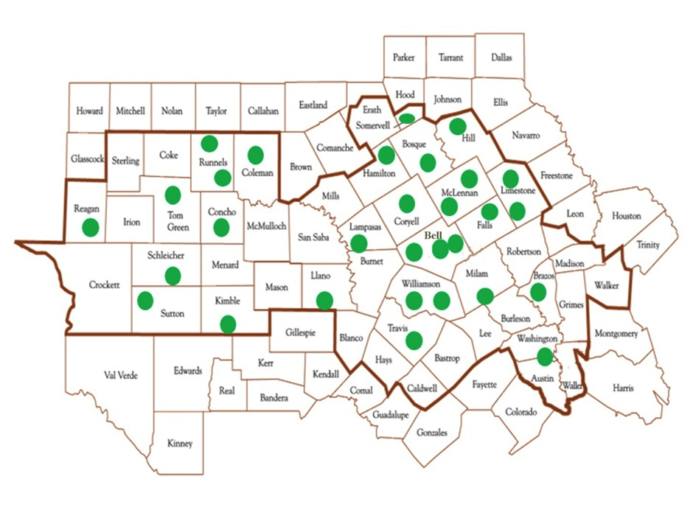
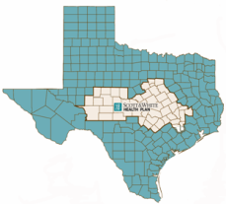
Service area
Hospital Locations
Notes:
Scott & White Health Plan is available in 49 counties across Central and West Texas. You must live, work or reside in the Scott & White Health Plan service area. The green dots on the map represent hospital providers throughout the service area.

Slide 53
What’s new for 2014-2015
NCQA Leader: Scott & White Health Plan ranked the #1 rated Health Plan in Texas by NCQA
Temple-based Scott & White Healthcare merged with Dallas-based Baylor Health Care Systems to create the largest nonprofit health care organization in Texas and one of the largest in the country - Baylor Scott & White Health
Scott & White Health Plan (SWHP) is keeping their name
SWHP now has a commercial contract with all Baylor facilities and Health Texas Physician Network (HTPN) in the DFW area
SWHP has filed for a commercial service are a expansion into the DFW area
Notes:
The National Committee for Quality Assurance (NCQA)

Slide 54
$20 PCP office visit $50 Specialty office visit
Benefit | Copay
Medical Deductible | $1,000 Individual / $3,000 Family
Out-of-Pocket Maximum | $3,000 individual / $6,000 family (includes combined Medical and RX copays and coinsurance)
Primary Care Physician | $20
Specialist Office Visit | $50
Preventive Care | $0
Outpatient Surgery Facility | $150 copay plus 20% after deductible
Inpatient Hospital | $150 copay per day ($750 max) plus 20% after deductible
Urgent Care | $55
Emergency Room | $150 copay per visit, plus 20% after deductible ($150 copay waived if admitted within 24 hours)
See trs.swhp.org for full list of benefits.

Slide 55
Unlimited Rx benefit, plus only $3 for generic drugs!
Prescription Drugs
 | Retail (up to 34-day supply) | Mail Order (up to 90-day supply)
Rx Maximum | Unlimited
Rx Deductible Applies to Brand and Non-Preferred | $100 (Does not apply to generics) | $100 (Does not apply to generics)
Generic | $3 | $6
Preferred Brand* | 30% after deductible | 30% after deductible
Non-Preferred Brand | 50% after deductible | 50% after deductible
Non-Formulary | Greater of $50 or 50% after deductible | N/A
New this year – RX copays and coinsurance now apply to
Out-of-Pocket Maximum
* If a brand-name prescription is dispensed when a generic is available, a copay of 50% applies after deductible
Notes:
There is NO deductible on generic prescriptions. A $100 deductible applies to preferred brand, non-preferred brand and non-formulary prescriptions.
If you purchase your prescription drugs through a retail pharmacy, you’ll pay $3 for generic with no deductible and pay 30% after deductible for preferred brand. For non-preferred brand-name drugs, you’ll pay 50% after deductible. For non-formulary drugs, you’ll pay the greater of $50 or 50% after deductible. If a brand-name prescription is dispensed when a generic is available, a copay of 50% applies after deductible.
SWHP covers non-formulary prescriptions, some carriers do not.
For prescription drugs purchased through mail order with a SWHP pharmacy, you’ll pay $6 for generic with no deductible. For preferred brand drugs, you’ll pay 30% after the deductible. For non-preferred brand drugs, you’ll pay 50% after deductible. Non-formulary drugs are not available by mail order with Scott & White Health Plan.
Prescriptions may be filled at any Scott & White Health Plan pharmacy and all major retail pharmacies outside the Temple area — including most Walgreens, CVS, Wal-Mart, Target and HEB locations.

Slide 56
MyBenefits – online tools & mobile resources
MyChart (for Scott & White patients)
A new way to manage your health and wellness on a tablet, smartphone or computer
Now have direct online access to lab results, medications, appointment information, immunizations and more
Convenient way to communicate with doctor’s offices, renew prescriptions and schedule appointments
Log in to MyBenefits at www.swhp.org
Find a provider or pharmacy
View the Summary of Benefits (SOB / SBC)
See your Explanation of Benefits (EOB)
Order ID cards
Consult the Scott & White Health Plan formulary
Access online wellness programs
iPhone
Provider Locator app
Free, quick and easy way to locate any provider or facility in the SWHP network from an iPhone or iPod Touch

Slide 57
Unique integrated programs
Vitality Coordinators:
Health Plan-employed nurses that work in the clinical setting
Help with follow up care to manage chronic conditions
Coordinate services for immunizations, blood pressure checks, labs, medication refills and appointment assistance
Diabetes Days:
Free foot and eye exams, blood work and much more
Saturdays (in 5 different locations) throughout the year
Contact 254-298-3516 to schedule an appointment
Notes:
Diabetes Days: A patient centered program to screen diabetics in one convenient spot in a convenient time and free to SWHP members. Services include: eye exam, foot exam, blood work and pressure, weight, BMI and urine check.
Diabetic Days are on Saturdays throughout the year. Contact 254-298-3516 for an appointment time.

Slide 58
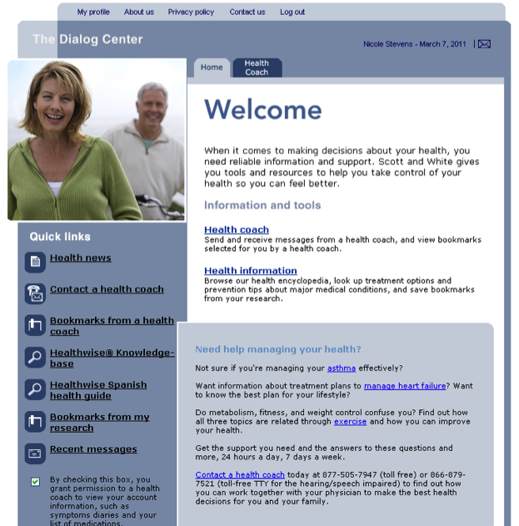
VitalCare – An approach to health and wellness
The Dialog Center
Shared Decision-Making
Condition Care Guidance Programs
Health Coaches
Available to answer your health questions by phone, anytime day or night: 1-877-505-7947
Online Lifestyle Management Programs
Succeed® Health Risk Assessment
10 additional Wellness programs
24-hour Nurse Advice Line
1-877-505-7947
Available to all SWHP members
Notes:
Dialog Center: What is shared decision-making? It’s about making health care decisions in partnership with your physician. You may have personal preferences and values that need to be considered when choosing treatment options. The Dialog Center can give you the risks and benefits of treatment options, provide different points of view about medical tests and treatments, help you understand how your lifestyle may be affected.
Health Coaches: Specially trained health care professionals, such as nurses, respiratory therapists and dietitians. Available 24 hours a day, 7 days a week. Using the values of shared decision-making, health coaches help you become more active in your health care. This includes: exploring the risks and benefits involved in a specific treatment plan, evaluating options based on your beliefs and way of life, provide access to additional resources such as websites, videos, books, pamphlets and community organizations.

Slide 59
Personalized service
Member Promise
If you are having difficulty getting an appointment to see Scott & White participating providers, please call the new personalized service at at 254-298-3000 or 800-321-7947. This service will get you an appointment to see a clinician when you need to be seen.
Urgent Care
Extended and weekend hours
Go to swhp.org for a complete list of locations
Enhanced Benefit - $55 copay (no deductible)

Slide 60
Things to remember
You are not required to select a Primary Care Physician.
You may see any network physician without a referral.
Maintained low fixed dollar copays:
— Primary Care $20
— Generic medications $3
Out-of-pocket maximums remain the same – $3,000 individual and $6,000 family
but now includes both Medical & Rx copays and coinsurance!

Slide 61
(formerly Valley Baptist Health Plans) HMO Plan Option 2014-2015 Plan Year
Allegian Health Plans
Notes:
In July 2014, Valley Baptist Health Plans became Allegian Health Plans – their superior customer service, quality health care and mission to deliver quality medical care to the members of their community here in the Rio Grande Valley has not changed – just their name!

Slide 62
Company overview
Allegian Health Plans, formerly Valley Baptist Health Plans, has been part of the TRS-ActiveCare program since 2003 and provides health care benefits to more than 2,900 school employees and their dependents throughout the Rio Grande Valley
They are a hospital-based health plan, founded in 1998 and were recently acquired by Tenet HealthCare in October 2013
They focus exclusively on the Valley and cover employees who live or work in Cameron, Hidalgo, Starr and Willacy counties
Valley Baptist Health Plans’ mission is to provide members with comprehensive health care coverage at an affordable price
Notes:
Allegian Health Plans has experienced steady membership growth over the past nine years. Currently, covering more than 1,300 school employees and their dependents.
Allegian Health Plans, formerly Valley Baptist Health Plans, is owned by Tenet HealthCare. Considering that their owner is a hospital system, they instill the need to put patient care first with the understating that health care decisions are made by local health providers, not by someone on the phone in a different state.
Allegian Health Plans is committed to the local community with an office in Harlingen where you can come by and ask questions.
Finally, the company’s mission is to provide their members with comprehensive health care coverage at an affordable price. Health care costs have been rapidly increasing due to new technology, drugs and increase in utilization. To help counterbalance this increase in cost, Allegian Health Plans had to make some benefit modifications which will be reviewed in the next couple of slides. While they never like to make benefit changes, doing so helped offset higher premiums, thus continuing to make Allegian Health Plans one of the most affordable options while still providing comprehensive benefits.

Slide 63
Benefit highlights
No routine claim forms
College-age dependents living outside the service area have full coverage (address must be on file)
Healthy Partners Program – designed to support and educate members with diabetes and allows members to receive their diabetic supplies at no cost. Participation is voluntary and there is no cost to join the program.
Secure online access to your membership and claim information at www.allegianhealthplans.com
NOTE: Care must be accessed through the wrap network PHCS/MultiPlan.
To locate a PHCS/MultiPlan provider visit www.phcs.com or call Customer Service at 855-463-7264
Notes:
By accessing care through a primary care physician, you will have a lower office visit copayment. The provider network includes more than 1,000 doctors in the four-county service area. A complete listing of providers is available at www.allegianhealthplans.com under the TRS tab.
When you access care from participating providers, all you have to do is show your ID card. Allegian Health Plans will coordinate payment directly with providers, thus eliminating the need to file routine claim forms.
Many of Allegian Health Plans’ members have college-age dependents that reside outside the service area. No problem. They are covered for all services, including routine, non-emergency care as long as the care is provided by a doctor or facility that is contracted with Allegian Health Plans or our affiliated network, PHCS/MultiPlan. In order to receive this comprehensive level of benefits, the student’s out-of-area address must be on file with Allegian Health Plans. This can be done by simply calling the Customer Service department at 1-855-463-7264
Allegian Health Plans’ members have access to a robust secure website. You can review claim and benefit information, send an email to customer service, print benefit and plan information and research ways to promote a healthy lifestyle.

Slide 64
Monthly Premium Rates for 2014-2015
Coverage Category | 2014-2015
Employee Only | $400.20
Employee and Spouse | $969.60
Employee and Child(ren) | $627.14
Family | $989.22
Notes:
As discussed in the company overview slide, Allegian Health Plans’ mission is to provide comprehensive coverage at an affordable price.

Slide 65
Medical benefit comparison for 2014-2015
2013-2014 | 2014-2015
Deductible $500 per individual $1,000 per family | Deductible $500 per individual $1,000 per family
Out-of-Pocket Maximum $4,000 per individual $8,000 per family | Out-of-Pocket Maximum $4,500 per individual $9,000 per family
Office Visit Primary Care – $25 Specialist – $60 | Office Visit Primary Care – $25 Specialist – $60
Inpatient / Outpatient Copayment 20% – after deductible (member share) | Inpatient / Outpatient Copayment 20% – after deductible (member share)
Notes:
This chart outlines some of the changes in the medical plan. The out-of-pocket maximum has increased slightly to $4,500/individual and $9,000/family. However, the out-of-pocket maximum will now include deductible and copays. Please refer to the Schedule of Benefits and Evidence of Coverage for a complete overview of coverage.

Slide 66
Rx benefit comparison for 2014-2015
2013-2014 | 2014-2015
Deductible $50 per individual | Deductible $100 per individual
Rx Yearly Maximum Unlimited | Rx Yearly Maximum Unlimited
Copayments Tier 1 – $10 Tier 2 – $30 Tier 3 – $65 Tier 4 – N/A | Copayments Tier 1 – $10 Tier 2 – $40 Tier 3 – $65 Tier 4 – 20%
Formulary Open | Formulary Closed
Notes:
This chart outlines some of the changes to the prescription drug plan.

Slide 67
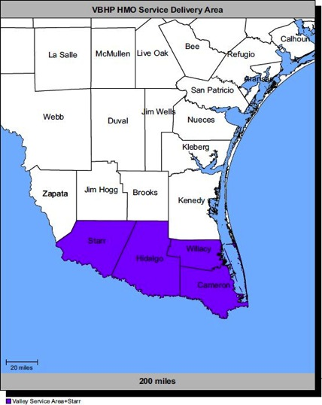
Allegian Health Plans
Service Area
Rio Grande Valley
Counties
Cameron
Hidalgo
Starr
Willacy
Provider Network
More than 1,000 providers
12 hospitals Valley-wide
Notes:
In order to be in the plan, you must live or work in one of the shaded areas. Allegian Health Plans’ service area includes four counties in the Rio Grande Valley. With an office in Harlingen, they are able to offer truly local service.
Within the four counties there are over 1,000 participating providers, including some of the most well-respected hospitals and physicians. While they strive to make sure these providers continue participating in their program, there is no guarantee they will continue to participate throughout the year. Please check the provider’s participation status before seeking care.

Slide 68
Allegian Health Plans Provider Network
Harlingen Hospitals:
Valley Baptist Medical Center
Harlingen Medical Center
Other Regional Hospitals:
Valley Baptist Medical Center-Brownsville
Knapp Medical Center
McAllen Medical Center
McAllen Heart Hospital
Doctor’s Hospital Renaissance
Edinburg Regional Hospital
Edinburg Children’s Hospital
Cornerstone Regional Hospital
Mission Hospital
Starr County Memorial Hospital
Allegian Health Plans has a comprehensive network of local physicians, hospitals, and pharmacies that offer a full range of medical services.
A complete list of network providers is available at www.allegianhealthplans.com.
Harlingen office is located at:
2005 Ed Carey Drive Harlingen, TX 78550 (956) 389-2273
Come visit us and meet the staff.
Notes:
At the Allegian Health Plans’ website, you will find instructions on how to find a participating doctor and a list of participating hospitals.

Slide 69
Why choose Allegian Health Plans?
Experience with TRS-ActiveCare benefits. Covering more than 2,900 school employees and their dependents; the HMO plan option in the Rio Grande Valley since 2003.
A hospital-based health plan that supports local communities
Medical decisions are made locally by physicians who understand how health care is delivered in the Valley
A dedicated Allegian Health Plans representative who has worked closely with TRS members over the years, is available to assist with questions, problems or needed assistance
Unique e-mail address for TRS members and Benefits Administrators, as well as a dedicated Customer Service line for TRS members
Notes:
One of the many benefits of participating in the TRS-ActiveCare program is the opportunity for you to choose from several outstanding health care options. Allegian Health Plans is proud to be one of those companies. Their participation in TRS spans over 10 years, insuring more than 2,900 school employees and their dependents.
Allegian Health Plans’ is a Texas hospital-based health plan, that believes medical decisions should be made locally by physicians who understand how health care is delivered in their communities.
They have local representation available to conduct meetings at your school to make sure you are informed on how the benefits work.
In addition, the Customer Service Department is available to answer your questions either by calling or sending an email. The email address is constantly monitored and a great way to request ID cards, research claims and ask benefit questions.

Slide 70
Contact us
You may submit your questions or comments
via e-mail to TRS-customerservice@coniferhealth.com
You can also write or call customer service at:
Valley Baptist Health Plans
2005 Ed Carey Dr. Harlingen, TX 78550
855-463-7264
http://www.trs.state.tx.us/trs-activecare
Notes:
You may contact Lee Helm at 956-389-2257 or lindell.helm@allegianhealthplans.com or Customer Service with questions or assistance with the Allegian Health Plans benefits for the 2014-15 Plan Year.

Slide 71
2014-2015 Plan Year
Who is eligible?

Slide 72
Who is eligible to enroll?
To be eligible for TRS-ActiveCare coverage, you must:
Be employed by a participating district/entity and
Be an active, contributing TRS member or
Be employed 10 or more regularly scheduled hours each week
Health care coverage for public school employees and their families
Notes:
Who can enroll in TRS-ActiveCare?
To be eligible for TRS-ActiveCare, you must be employed by a participating entity. Then, ask yourself these questions:
(1) Are you an active, contributing TRS member?
(2) Are you employed for 10 or more regularly scheduled hours each week?
If the answer is yes to either question, then you are eligible for TRS-ActiveCare coverage.

Slide 73
Employees NOT eligible to enroll
State of Texas employees or retirees
Higher education employees or retirees
TRS retirees, receiving or who declined coverage under TRS-Care
These individuals are not eligible to enroll for TRS-ActiveCare coverage as employees, but they can be covered as a dependent of an eligible employee.
Notes:
Employees that are not eligible to enroll in TRS-ActiveCare include individuals:
Receiving health care coverage as an employee or retiree under the Texas State College and University Employees Uniform Insurance Benefits Act, for example, a school employee that has UT SELECT coverage as an employee with The University of Texas System.
Receiving health care coverage as an employee or retiree under the Texas Employee Uniform Group Insurance Benefits Act, for example, a school employee that has HealthSelect coverage as an employee with ERS.
A TRS retiree receiving, or who waived coverage, under TRS-Care, including a retiree who has returned to work. Note: If a retiree has returned to work and has never been eligible for TRS-Care, he or she would be eligible for TRS-ActiveCare coverage, as long as the retiree meets all the TRS-ActiveCare eligibility requirements.
Basically, employee coverage is not available from two state sources.
However, these individuals–retirees, higher education and state of Texas employees–while they are not eligible to enroll for TRS-ActiveCare coverage as employees, they can be covered as a dependent of an eligible employee.

Slide 74
Dependent eligibility
Spouse, including common law spouse
A child under age 26: a natural child, an adopted child (or a child who is lawfully placed for legal adoption), foster child, or child under legal guardianship of the employee
“Any other child” under the age of 26 (unmarried) in a regular parent-child relationship with the employee – Must meet residency and support criteria
A grandchild under age 26
Unmarried disabled dependent (age 26+) – Must live with employee
A dependent does not include a brother or sister of an employee unless the sibling is an unmarried individual under 26 years of age who is either: (1) under the legal guardianship of the employee, or (2) in a regular parent-child relationship with the employee and meets the “any other child” criteria
Parents and grandparents of the covered employee do not meet the definition of an eligible dependent
Notes:
Eligible dependents can include:
A spouse (including a common law spouse)*
A child under the age of 26 such as:
A natural child
An adopted child or a child who is lawfully placed for legal adoption
A stepchild
A foster child
A child under the legal guardianship of the employee
“Any other child” under age 26 (unmarried) in a regular parent-child relationship with the employee (other than a child described in the category immediately above), meaning:
The child's primary residence is the household of the employee;
The employee provides at least 50% of the child's support;
Neither of the child's natural parents resides in that household; and
The employee has the legal right to make decisions regarding the child's medical care
A grandchild under age 26 whose primary residence is the household of the employee and who is a dependent of the employee for federal income tax purposes for the reporting year in which coverage of the grandchild is in effect.
A child of a covered employee, age 26 or over, may be eligible for dependent coverage, provided that the child is either mentally or physically incapacitated to such an extent to be dependent on the employee on a regular basis as determined by TRS, and meets other requirements as determined by TRS.
A dependent does not include a brother or a sister of an employee unless the brother or sister is an unmarried individual under 26 years of age who is either: (1) under the legal guardianship of the employee, or (2) in a regular parent-child relationship with an employee, as defined in the “any other child” category above. Parents and grandparents of the covered employee do not meet the definition of an eligible dependent.
*A common law marriage is not considered a special enrollment event unless there is a Declaration of Common Law led with an authorized government agency.

Slide 75
Special eligibility situations
If employee and spouse both work for a participating district/entity:
A spouse may be covered as an employee or as a dependent of an employee
Only one parent can cover dependent children
A child (under age 26) employed by a district/entity and a contributing TRS member cannot be covered as a dependent
The child must be covered as an employee
If the child is not a contributing TRS member, the child may be covered as a dependent
Notes:
If an employee and spouse both work for a participating district/entity:
Each employee can apply
Each employee can choose employee-only coverage and select the same or different plans
One employee can select employee and spouse coverage, and the spouse must decline coverage
One employee can choose employee-only coverage, and the spouse can choose the same or different plan for employee and child(ren) coverage
One employee can select employee and family coverage, and the spouse must decline coverage
Only one parent may enroll dependent children for coverage.
What if a child works for a participating entity?
A child (under age 26) who is employed by a district/entity and is a contributing TRS member cannot be covered as a dependent on his or her parent's TRS-ActiveCare coverage. This child must be covered as an employee. If the child is not a contributing TRS member, the child may be covered as a dependent.

Slide 76
2014-2015 Plan Year
Online Enrollment

Slide 77
Three steps to enroll
1 Choose your health plan
2 Log in to WellSystems Enrollment Portal and make any additions, changes or plan elections
3 Submit transaction – It will be reviewed and approved by your Benefits Administrator
Notes:
You can log in to WellSystems Enrollment Portal to submit any additions, changes or plan elections.

Slide 78
Annual enrollment
Enrollment Period for 2014-2015 Plan Year: July 21– August 31 (Annual Enrollment)
Use the Enrollment Guide and Provider Directories to pick a Plan and coverage that is right for you
Passive enrollment – If no plan or coverage changes, then no form required
Premium adjusted to reflect any rate change, effective September 1
Exception: If an employee is currently enrolled in ActiveCare 3, he or she will be automatically enrolled in ActiveCare 2 effective September 1, 2014, unless you submit an Enrollment Application and Change Form to select a different TRS-ActiveCare plan option or terminate coverage
Notes:
The plan enrollment period for the 2014-2105 plan year is July 21 – August 31.
If no form is returned, you will automatically be enrolled in the same plan elected for 2013-2014 at the same level of coverage. The premium will be adjusted to reflect any rate change that will become effective September 1, 2014.
There is one exception to the passive enrollment: The ActiveCare 3 plan option will be discontinued for the 2014-2015 plan year. If you are currently enrolled in ActiveCare 3, you will be transitioned into ActiveCare 2 at the same level of coverage effective September 1, 2014. If you do not want to be enrolled in ActiveCare 2, you must submit an Enrollment Application and Change Form during the plan enrollment periods to select a different TRS-ActiveCare plan option or terminate TRS-ActiveCare coverage.
You are encouraged to read the enrollment guide and review the plans carefully. Rates and/or benefits for every TRS-ActiveCare plan option have changed.
Clarification: If you are already enrolled in TRS-ActiveCare and change employment to a new participating district/entity, you need to complete and return a new enrollment form.
Note to Benefits Administrators: If you have a third party vendor administering your Section 125 cafeteria plan, be sure the vendor communicates the processing guidelines correctly to the employees. All changes to TRS-ActiveCare must be submitted to the Benefits Administrator through the WellSystems Enrollment Portal or on an Enrollment Application and Change Form. Making a change through a third party vendor for a Section 125 cafeteria plan does not automatically generate a change to TRS-ActiveCare.

Slide 79
Enrolling in the Plan – New enrollee New Enrollee
Complete the enrollment process by registering on the WellSystems Enrollment Portal
The WellSystems Enrollment Portal can be accessed directly by employees to enroll or change coverage/self-service sign-on. Go to: https://www.wellsystems-mesa.com/TRS
If you are a new enrollee
You will need to establish a username and password
Enter the required information (* Indicates that it is a mandatory field)
Once all required fields are completed, enter your first and last name in the verification field
Verify the date of the signature and click continue
You will receive a notification that you have been successfully registered
Now you are ready to enroll
Log in to the WellSystems Enrollment Portal using your username and password you created during registration
Complete the fields. Remember * indicates that it is a mandatory field
Click save and continue to the dependent page if applicable
If there are no dependents to enroll check “I do not wish to or need to cover dependents”
Notes:
Who needs to enroll?
New hires
Enrolling or declining TRS-ActiveCare coverage
Enrolling for TRS-ActiveCare coverage with a different participating district/entity
Employees already enrolled, but making changes such as:
Changing to a different TRS-ActiveCare plan option
Adding or dropping dependents
Choosing to cancel and/or decline coverage under TRS-ActiveCare
Changing name or address and/or correcting date of birth or Social Security number
Remember, you must enroll/or change through the Enrollment Portal if you change employment during the plan year and enroll for TRS-ActiveCare coverage with another participating district/entity.
Note: Because the ActiveCare 3 plan option is being discontinued, current enrollees in ActiveCare 3 will automatically be enrolled in ActiveCare 2 at the same level of coverage, effective September 1, 2014. The employee must enroll during the plan enrollment period to select a different plan option or to terminate TRS-ActiveCare coverage.

Slide 80
Enrolling for the first time
The enrollment must be completed before:
The end of the plan enrollment period, or
31 calendar days after the employee’s actively-at-work date, or
31 calendar days after a special enrollment event
New hires may choose their effective date of coverage
Actively-at-work date, or
First of the month following their actively-at-work date
Full premium for the month will be due if choosing actively-at-work date; premiums are not pro-rated
Notes:
What do you need to do to enroll in TRS-ActiveCare for the first time?
You will need to register and enroll through the WellSystems Enrollment Portal or sign and submit an Enrollment Application and Change Form to the Benefits Administrator before:
The end of the plan enrollment period, or
31 calendar days after the your actively-at-work date, or
31 calendar days after a special enrollment event (Special rules apply to adding newborns; see page 20 of the Enrollment Guide for more information)
As a new hire, you may choose as your effective date of coverage your actively-at-work date (the date you start to work) or the first of the month following your actively-at-work date. When choosing the actively-at-work date, the full premium for the month will be due; premiums are not pro-rated.

Slide 81
Enrolling in the Plan – Returning enrollee Returning Enrollee
If you are an returning enrollee and would like to make changes:
Log in to the WellSystems Enrollment Portal using your username and password you created during registration
Complete the fields – remember (* indicates that it is a mandatory field)
Click save and continue to the dependent page, if applicable
If there are no dependents to enroll, check, “I do not wish to or need to cover dependents”
Add or drop dependents
Select a different TRS-ActiveCare plan option
Cancel and/or decline coverage
Update name, address or any other demographic information
Current enrollees in ActiveCare 3 will automatically be enrolled in ActiveCare 2, effective September 1, 2014
Notes:
First, you must register in the WellSystems Enrollment Portal and establish a user name and password. Log in to the portal and complete the fields. (The field marked with a red* are mandatory.)
You can make changes, add or cancel dependents, decline coverage and/or update any demographic information. You may also select a different TRS-ActiveCare plan option.

Slide 82
Making changes/special enrollment events
Enrollees may be able to enroll for coverage, change plan options or change the dependents covered during the plan year within 31 days after a special enrollment event occurs
New dependent
Marriage, birth, adoption or placement for adoption
Special rules apply to newborns
Loss of other coverage
Changing districts/entities is not considered a special enrollment event.
Notes:
You may be able to enroll for coverage, change plan options, or change the dependents you cover during a plan year if you or a dependent has a special enrollment event. Changes in employee and/or dependent coverage must be made within 31 days after the special enrollment event. (Special rules apply to newborns; see page 20 of the Enrollment Guide—and next slide—for more information.) If you do not request the appropriate changes during the applicable special enrollment period, the changes cannot be made until the next plan enrollment period or, if applicable, until another special enrollment event occurs.
One example of a special enrollment event is gaining a new dependent as a result of marriage, birth, adoption or placement for adoption. Note that a common law marriage is not considered a special enrollment event unless there is a Declaration of Common Law Marriage filed with an authorized government agency.
Please note – If you are enrolled in the ActiveCare Select – Aetna Whole Health network and move out of the Aetna Whole Health network area during the 2014-2015 plan year, you will remain in the ActiveCare Select plan and may choose providers in the ActiveCare Select (Open Access) network. You will receive a new ID card indicating the network charge.
Another example of a special enrollment event is loss of other coverage. Loss of coverage qualifies as a special enrollment event if:
You and/or dependent(s) lost other coverage due to a loss of eligibility
You and/or dependent(s) elected to drop the other group health coverage because the employer stopped all employer contributions toward the premium (including any employer-paid COBRA premium)
You and/or dependent(s) exhausted their COBRA continuation coverage
Changing districts/entities is not considered a special enrollment event under TRS-ActiveCare.

Slide 83
Newborn coverage
Covered first 31 days, if you have coverage
Does not apply to newborn grandchildren
Must add newborn within 60 days after the date of birth or up to one year after the date of birth if:
You have “employee and family” or “employee and child(ren)” coverage at the time of birth and at the time of enrollment
Plan changes must be made within 31 days after the newborn’s date of birth
Not necessary to wait for newborn’s Social Security number (SSN)
Submit application without SSN to enroll
Re-submit another form after SSN is issued
Notes:
No rule changes, but always worth mentioning: Throughout the Administrative Guide and the new Enrollment Guide, you’ll see references to “Special rules apply to newborns” with information about making changes/adding coverage. Here are the rules for newborns: TRS-ActiveCare automatically provides coverage for a newborn child of a covered employee for the first 31 days after the date of birth. To add coverage for the newborn, you must sign, date and submit an Enrollment Application and Change Form to the Benefits Administrator within 60 days after the date of birth. However, you have up to one year after the newborn's date of birth to add the newborn to coverage if you have employee and family or employee and child(ren) coverage with TRS-ActiveCare at the time of the newborn’s birth and at the time of enrollment.
Even though you have more time to add a newborn to coverage as described above, changing plans must be made within 31 days after the newborn’s date of birth.
Note: It is not necessary to wait for the newborn’s Social Security number to enroll. You should submit an Enrollment Application and Change Form without the Social Security number to add coverage and re-submit another form or use Blue Access for Employers once the number has been issued.

Slide 84
Dependent disability process
Dependent Child’s Statement of Disability:
A letter will be sent to the employee advising the loss of coverage for the dependent on their birthday unless they provide details of their disability
Employee completes the Request for Continuation of Coverage for Handicapped Child form and requests physician to complete the Attending Physicians Form
Completed forms are to be faxed or mailed along with any supporting documentation the physician includes for review. Fax # /address for submission are noted on the forms.
If notification from Aetna is not provided advising Approval of Disability, the dependent’s enrollment will be terminated on the last day of the month in which the 26th birthday occurs.
Notes:
Dependent Child’s Statement of Disability
NOTE: The employee should receive a notice 60 days prior to the dependent child’s 26th birthday. The employee should complete the Request for Continuation of Coverage for Handicapped Child form and Attending Physician’s Statement and return to Aetna for approval.
If a form is not received, the dependent child’s coverage will terminate on the first of the month following the birthday.
Completed forms can be faxed or mailed.

Slide 85
Split Premium Process
Split Premium Form:
The Split Premium Form must be completed and signed by both husband and wife who wish to split the cost of employee and spouse or employee and family
Must be employed by different districts/entities participating in TRS-ActiveCare
The cost for TRS-ActiveCare coverage will be split between the two employers
One employee must decline coverage
The Benefits Administrator must also sign and approve the form
The employee who declined coverage is considered as being covered under a group health plan
Notes:
What does the employee need to do to for the Split Premium process?
The employee will need to sign and submit the Split Premium form to both Benefits Administrators
Both Benefit Administrators will need to sign the form
The employees must be employed by different districts that are participating in TRS-ActiveCare.
The cost of the premium will be split between the two employers
One of the employees must decline coverage

Slide 86
2014-2015 Plan Year
Paper Submissions Enrollment

Slide 87
Three Steps to Enroll
Three steps to enroll
1 Choose your health plan
2 Complete an Enrollment Application and Change Form Available online or from your Benefits Administrator
3 Sign, date and submit form to your Benefits Administrator

Slide 88
Annual enrollment
Enrollment Period for 2014-2015 Plan Year: July 21– August 31 (Annual Enrollment)
Use the Enrollment Guide and Provider Directories to pick a Plan and coverage that is right for you
Passive enrollment – If no plan or coverage changes, then no form required
Premium adjusted to reflect any rate change, effective September 1
Exception: If you are currently enrolled in ActiveCare 3, you will be automatically enrolled in ActiveCare 2 effective September 1, 2014, unless you submit an Enrollment Application and Change Form to select a different TRS-ActiveCare plan option or terminate coverage
Notes:
The plan enrollment period for the 2014-2105 plan year is: July 21 – August 31 (Annual Enrollment). If no form is returned, you will automatically be enrolled in the same plan elected for 2013-2014 at the same level of coverage. The premium will be adjusted to reflect any rate change that will become effective September 1, 2014.
There is one exception to the passive enrollment: The ActiveCare 3 plan option will be discontinued for the 2014-2015 plan year. If you are currently enrolled in ActiveCare 3, you will be transitioned into ActiveCare 2 at the same level of coverage effective September 1, 2014. If you do not want to be enrolled in ActiveCare 2, you must submit an Enrollment Application and Change Form during the plan enrollment period to select a different TRS-ActiveCare plan option or terminate TRS-ActiveCare coverage.
It is important that you read the enrollment guide and review the plans carefully. Rates and/or benefits for every TRS-ActiveCare plan option have changed.
Clarification: If you are already enrolled in TRS-ActiveCare and change employment to a new participating district/entity, you need to complete and return a new enrollment form.
Note to Benefits Administrators: If you have a third party vendor administering your Section 125 cafeteria plan, be sure the vendor communicates the processing guidelines correctly to the employees. All changes to TRS-ActiveCare must be submitted to the Benefits Administrator through the WellSystems Enrollment Portal or on an Enrollment Application and Change Form. Making a change through a third party vendor for a Section 125 cafeteria plan does not automatically generate a change to TRS-Active.

Slide 89
Enrollment Application and Change Form
Complete the enrollment process by using the Enrollment Application and Change Form.
If you are a new enrollee:
Enter all the requested information for you and any dependents you want to cover
Choose coverage that is good for you
Sign the Enrollment Application and Change Form
Return the form to your Benefits Administrator
If you are an existing employee:
Select a different TRS-ActiveCare plan option
Add or drop dependents
Cancel and/or decline coverage (cancellations and declinations must be completed on two separate forms)
Update name, address or any other demographic information
Sign the Enrollment Application and Change Form
Return the form to your Benefits Administrator
Current enrollees in ActiveCare 3 will automatically be enrolled in ActiveCare 2, effective September 1, 2014; you must submit a form to select a different plan option
Notes:
Who needs to submit an Enrollment Application and Change Form?
New hires
Enrolling or declining TRS-ActiveCare coverage
Enrolling for TRS-ActiveCare coverage with a different participating district/entity
Employees already enrolled, but making changes such as:
Changing to a different TRS-ActiveCare plan option
Adding or dropping dependents
Choosing to cancel and/or decline coverage under TRS-ActiveCare (cancellations and declinations must be completed on two separate forms)
Changing name or address and/or correcting date of birth or Social Security number
Remember, you must submit an Enrollment Application and Change Form if you change employment during the plan year and enroll for TRS-ActiveCare coverage with another participating district/entity.
Note: Because the ActiveCare 3 plan option is being discontinued, current enrollees in ActiveCare 3 will automatically be enrolled in ActiveCare 2 at the same level of coverage, effective September 1, 2014. The employee must submit an Enrollment Application and Change Form during the plan enrollment period to select a different plan option or to terminate TRS-ActiveCare coverage.

Slide 90
Enrolling for the first time
Enrolling for the first time:
Forms are due to the Benefits Administrator before:
The end of the plan enrollment period, or
31 calendar days after your actively-at-work date, or
31 calendar days after a special enrollment event
New hires may choose their effective date of coverage
Actively-at-work date, or
First of the month following their actively-at-work date
Full premium for the month will be due if choosing actively-at-work date; premiums are not pro-rated
Notes:
What do you need to do to enroll in TRS-ActiveCare for the first time?
You will need to sign and submit an Enrollment Application and Change Form to the Benefits Administrator before:
The end of the plan enrollment period, or
31 calendar days after the your actively-at-work date, or
31 calendar days after a special enrollment event (Special rules apply to adding newborns; see page 20 of the Enrollment Guide for more information)
As a new hire, you may choose as your effective date of coverage your actively-at-work date (the date you start to work) or the first of the month following your actively-at-work date. When choosing the actively-at-work date, the full premium for the month will be due; premiums are not pro-rated.

Slide 91
Making changes/special enrollment events
Enrollees may be able to enroll for coverage, change plan options or change the dependents covered during the plan year within 31 days after a special enrollment event occurs
New dependent
Marriage, birth, adoption or placement for adoption
Special rules apply to newborns
Loss of other coverage
Changing districts/entities is not considered a special enrollment event.
Notes:
You may be able to enroll for coverage, change plan options, or change the dependents you cover during a plan year if you or a dependent has a special enrollment event. Changes in employee and/or dependent coverage must be made within 31 days after the special enrollment event. (Special rules apply to newborns; see page 20 of the Enrollment Guide—and next slide—for more information.) If you do not request the appropriate changes during the applicable special enrollment period, the changes cannot be made until the next plan enrollment period or, if applicable, until another special enrollment event occurs.
One example of a special enrollment event is gaining a new dependent as a result of marriage, birth, adoption or placement for adoption. Note that a common law marriage is not considered a special enrollment event unless there is a Declaration of Common Law Marriage filed with an authorized government agency.
Please note – If you are enrolled in the ActiveCare Select – Aetna Whole Health network and move out of the Aetna Whole Health network area during the 2014-2015 plan year, you will remain in the ActiveCare Select plan and may choose providers in the ActiveCare Select (Open Access) network. You will receive a new ID card indicating the network charge.
Another example of a special enrollment event is loss of other coverage. Loss of coverage qualifies as a special enrollment event if:
You and/or dependent(s) lost other coverage due to a loss of eligibility
You and/or dependent(s) elected to drop the other group health coverage because the employer stopped all employer contributions toward the premium (including any employer-paid COBRA premium)
You and/or dependent(s) exhausted their COBRA continuation coverage
Changing districts/entities is not considered a special enrollment event under TRS-ActiveCare.

Slide 92
Newborn coverage
Covered first 31 days, if you have coverage
Does not apply to newborn grandchildren
Must add newborn within 60 days after the date of birth or up to one year after the date of birth if:
You have “employee and family” or “employee and child(ren)” coverage at the time of birth and at the time of enrollment
Plan changes must be made within 31 days after the newborn’s date of birth
Not necessary to wait for newborn’s Social Security number (SSN)
Submit application without SSN to enroll
Re-submit another form after SSN is issued
Notes:
No rule changes, but always worth mentioning: Throughout the Administrative Guide and the new Enrollment Guide, you’ll see references to “Special rules apply to newborns” with information about making changes/adding coverage. Here are the rules for newborns: TRS-ActiveCare automatically provides coverage for a newborn child of a covered employee for the first 31 days after the date of birth. To add coverage for the newborn, you must sign, date and submit an Enrollment Application and Change Form to the Benefits Administrator within 60 days after the date of birth. However, you have up to one year after the newborn's date of birth to add the newborn to coverage if you have employee and family or employee and child(ren) coverage with TRS-ActiveCare at the time of the newborn’s birth and at the time of enrollment.
Even though you have more time to add a newborn to coverage as described above, changing plans must be made within 31 days after the newborn’s date of birth.
Note: It is not necessary to wait for the newborn’s Social Security number to enroll. You should submit an Enrollment Application and Change Form without the Social Security number to add coverage and re-submit another form.

Slide 93
Dependent disability process
Dependent Child’s Statement of Disability:
A letter will be sent to the employee advising the loss of coverage for the dependent on their birthday unless they provide details of their disability
Employee completes the Request for Continuation of Coverage for Handicapped Child form and requests physician to complete the Attending Physicians Form
Completed forms are to be faxed or mailed along with any supporting documentation the physician includes for review. Fax # /address for submission are noted on the forms.
If notification from Aetna is not provided advising Approval of Disability, the dependent’s enrollment will be terminated on the last day of the month in which the 26th birthday occurs.
Notes:
Dependent Child’s Statement of Disability
NOTE: The employee should receive a notice 60 days prior to the dependent child’s 26th birthday. The employee should complete the Request for Continuation of Coverage for Handicapped Child form and Attending Physician’s Statement and return to Aetna for approval.
If a form is not received, the dependent child’s coverage will terminate on the first of the month following the birthday.
Completed forms can be faxed or mailed.

Slide 94
Split Premium Process
Split Premium Form:
The Split Premium Form must be completed and signed by both husband and wife who wish to split the cost of employee and spouse or employee and family.
Must be employed by different districts/entities participating in TRS-ActiveCare
The cost for TRS-ActiveCare coverage will be split between the two employers
One employee must decline coverage
The Benefits Administrator at each district must also sign and approve the form
The employee who declined coverage is considered as being covered under a group health plan
Notes:
What does the employee need to do to for the Split Premium process?
The employee will need to sign and submit the Split Premium form to both Benefits Administrators
Both Benefit Administrators will need to sign the form
The employees must be employed by different districts that are participating in TRS-ActiveCare
The cost of the premium will be split between the two employers
One of the employees must decline coverage

Slide 95
2014-2015 Plan Year
Cost for health coverage
Notes:
Your Cost for Coverage
Chapter 1581, Texas Insurance Code, authorizes funding to help active employees who are TRS members—those making retirement contributions to the Teacher Retirement System of Texas—pay for TRS-ActiveCare coverage. Each district is required to contribute at least $150 per month per active TRS member for coverage. The state will contribute $75 per month per active TRS member. That’s a minimum of $225 per month to help you pay for health coverage.

Slide 96
Cost of coverage
Funding to Help Offset the Cost of TRS-ActiveCare Coverage
District/Entity (minimum) | $150
State of Texas | $75
Total Per Month | $225
Funding applies to active, contributing TRS members
Cost charts illustrate the monthly gross premiums
Notes:
Chapter 1581, Texas Insurance Code, authorizes funding to help active employees who are TRS members—those making retirement contributions to the Teacher Retirement System of Texas—pay for TRS-ActiveCare coverage. Currently, each district/entity is required to contribute at least $150 per month per active TRS member for coverage. (Your participating district/entity may contribute more.) The state currently contributes $75 per month per active TRS member. That’s a minimum of $225 per month to help employees pay for health coverage. This amount significantly reduces what employees will owe per month for the TRS-ActiveCare plan that they choose.
State funding is subject to appropriation by the Texas Legislature. The rates shown in the Enrollment Guide are the gross monthly premiums and do not include any funding amounts. [Benefits Administrators are encouraged to develop cost sheets that help employees determine their net monthly costs.]

Slide 97
Monthly cost for coverage
See page 17 of Enrollment Guide
$225 in district/entity and state funds to help pay for coverage
Notes:
This chart appears on page 17 of your Enrollment Guide. It shows the total cost for each of the TRS-ActiveCare plan options.
Chapter 1581, Texas Insurance Code, authorizes funding to help active employees who are TRS members—those making retirement contributions to the Teacher Retirement System of Texas—pay for TRS-ActiveCare coverage. Currently, each district/entity is required to contribute at least $150 per month per active TRS member for coverage. (Your participating district/entity may contribute more.) The state currently contributes $75 per month per active TRS member. That’s a minimum of $225 per month to help employees pay for health coverage. This amount significantly reduces what employees will owe per month for the TRS-ActiveCare plan that they choose.
State funding is subject to appropriation by the Texas Legislature. The rates shown in the Enrollment Guide are the gross monthly premiums and do not include any funding amounts. See your Benefits Administrators to determine your net monthly cost.
Note: New hires may choose their actively-at-work date (the date they start to work) or the first of the month following their actively-at-work date as their effective date of coverage. If choosing the actively-at-work date, the full premium for the month will be due; premiums are not pro-rated.

Slide 98
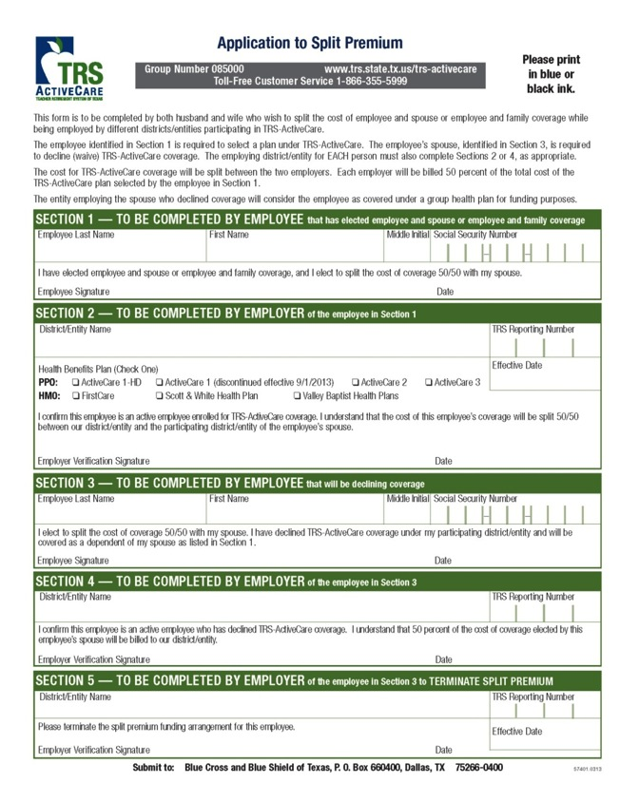
Application to split premium
Married couples working for different participating entities may “pool” funds
Optional
Requires an Application to Split Premium form to be completed by both employees and employers
Form available online
Notes:
If a husband and wife work for different participating entities and wish to “pool” funds, an Application to Split Premium must be completed. For the husband and wife who choose this option, the cost of coverage will be split between and billed to the two employers. Each employer will be billed 50% of the total cost of coverage. The entity employing the spouse who declined coverage will consider the employee as covered under a group health plan for funding purposes.
Each employee and their Benefits Administrator must complete their portion of the Application to Split Premium form which is available on the TRS-ActiveCare website, at www.trsactivecareaetna.com. This form should be submitted by the Benefits Administrator to WellSystems with the Enrollment Application and Change Form.
This form should not be used by employees working for the same entity.

Slide 99
ID cards (mailed to your home)
Medical plans (ActiveCare 1-HD, ActiveCare Select and ActiveCare 2)
Separate cards for medical and prescription drugs
Aetna
Caremark
All enrollees will receive new ID cards
HMO plans
Valley Baptish Health Plans – All enrollees will receive new ID cards.
Scott & White Health Plan and FirstCare Health Plans – only new enrollees will receive ID cards
Notes:
ActiveCare 1-HD, ActiveCare Select, ActiveCare 2: For the medical benefits (Aetna) the cards are “family cards” which means up to five covered family members will be listed on the card. If you have more than four dependents, you will receive an additional card listing your other dependents. Additional cards may be ordered from TRS-ActiveCare Customer Service at no charge.
All ID cards include a unique identification number instead of a Social Security number (SSN). New cards will be mailed to most employees by September 1, 2014. Multiple cards may be received. For example: If you receive a new ID card and subsequently make a change during the enrollment period, an updated card will be sent after the change is processed. Please destroy the first set of ID cards.

Slide 100
Thank you for attending
Questions?

Slide 101
TRS-ActiveCare is administered by Aetna Life Insurance Company (Aetna). Aetna provides claims payment services only and does not assume any financial risk or obligation with respect to claims. Prescription drug benefits for ActiveCare 1-HD, ActiveCare Select and ActiveCare 2 plans are administered by Caremark. HMO plans provided by: SHA, L.L.C. dba FirstCare Health Plans, Scott and White Health Plan, and Allegian Insurance Company dba Allegian Health Plan.
Notes:
TRS-ActiveCare is administered by Aetna Life Insurance Company (Aetna). Aetna provides claims payment services only and does not assume any financial risk or obligation with respect to claims. Prescription drug benefits for ActiveCare 1-HD, ActiveCare Select and ActiveCare 2 plans are administered by Caremark. HMO plans provided by: SHA, L.L.C. dba FirstCare Health Plans, Scott and White Health Plan, and Allegian Insurance Company dba Allegian Health Plans.

